Slide 1
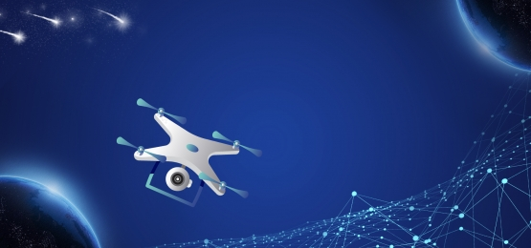
Assignment on
UNMANNED AERIAL VEHICLE (UAV)
BY KTC HUBLI
Group 3:
SHANKAR R
VINAYA
TABREZ
GURUPRASAD
KAIWALYA K
GUIDED BY:
MOHAMMAD TAHIR MIRJI
L2 Trainer KTC Hubli
Assignment for
Expert: Sabyasachi B

Slide 2
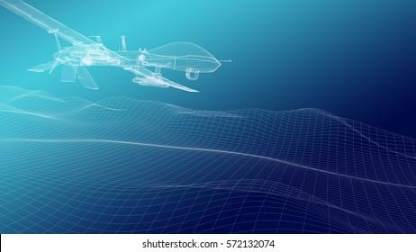
Introduction to drone
A drone, in a technological context, is an unmanned aircraft. Drones are more formally known as unmanned aerial vehicles (UAVs) or unmanned aircraft systems (UASes). Essentially, a drone is a flying robot.
The aircraft may be remotely controlled or can fly autonomously through software-controlled flight plans in their embedded systems working in conjunction with onboard sensors and GPS.

Slide 3
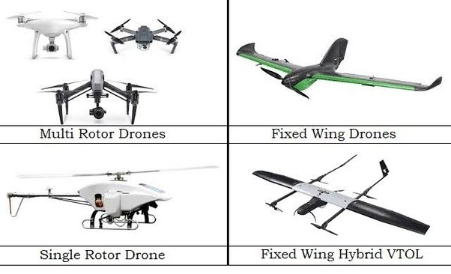
Different types of drones

Slide 4
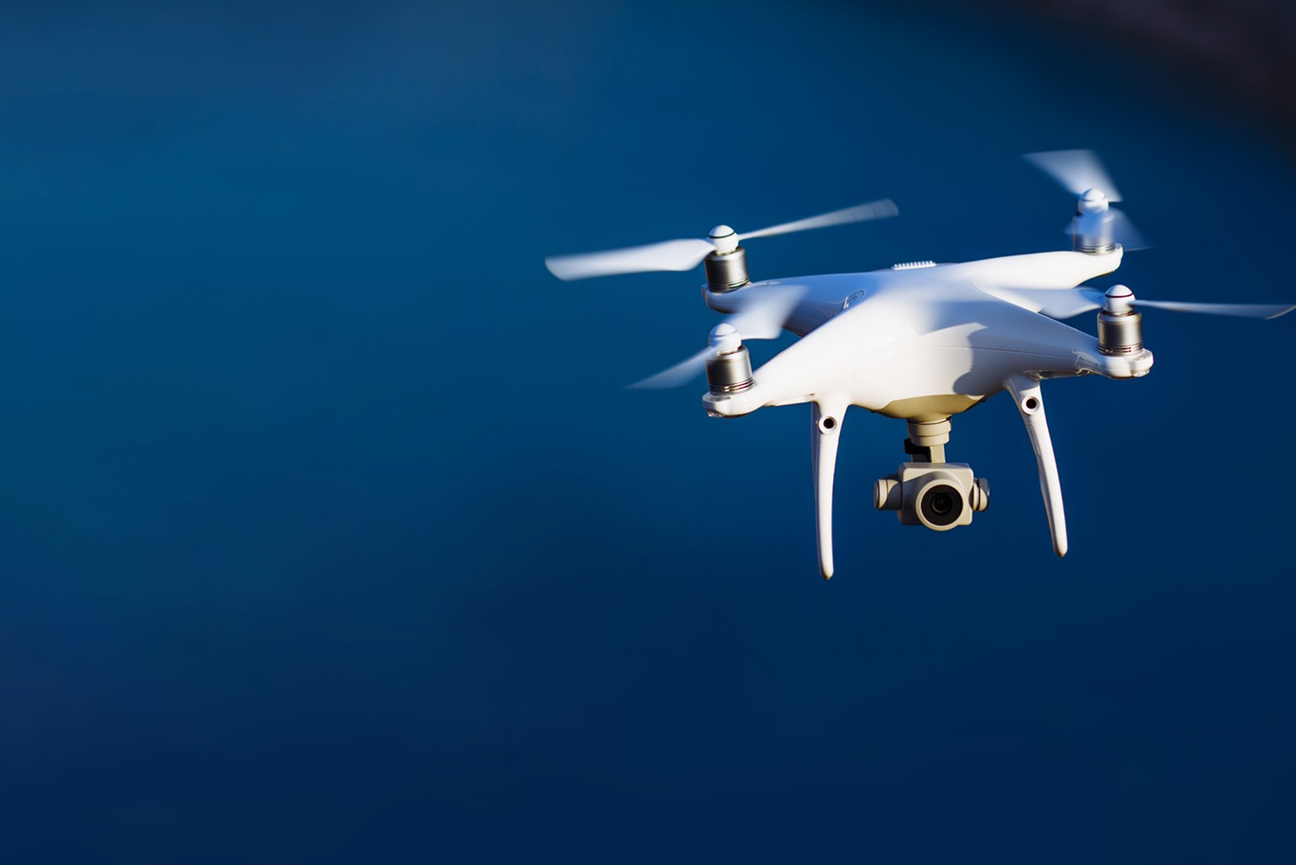
Applications of drones

Slide 5
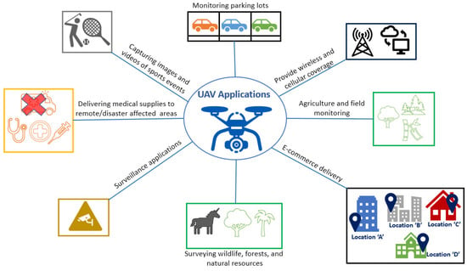

Slide 6
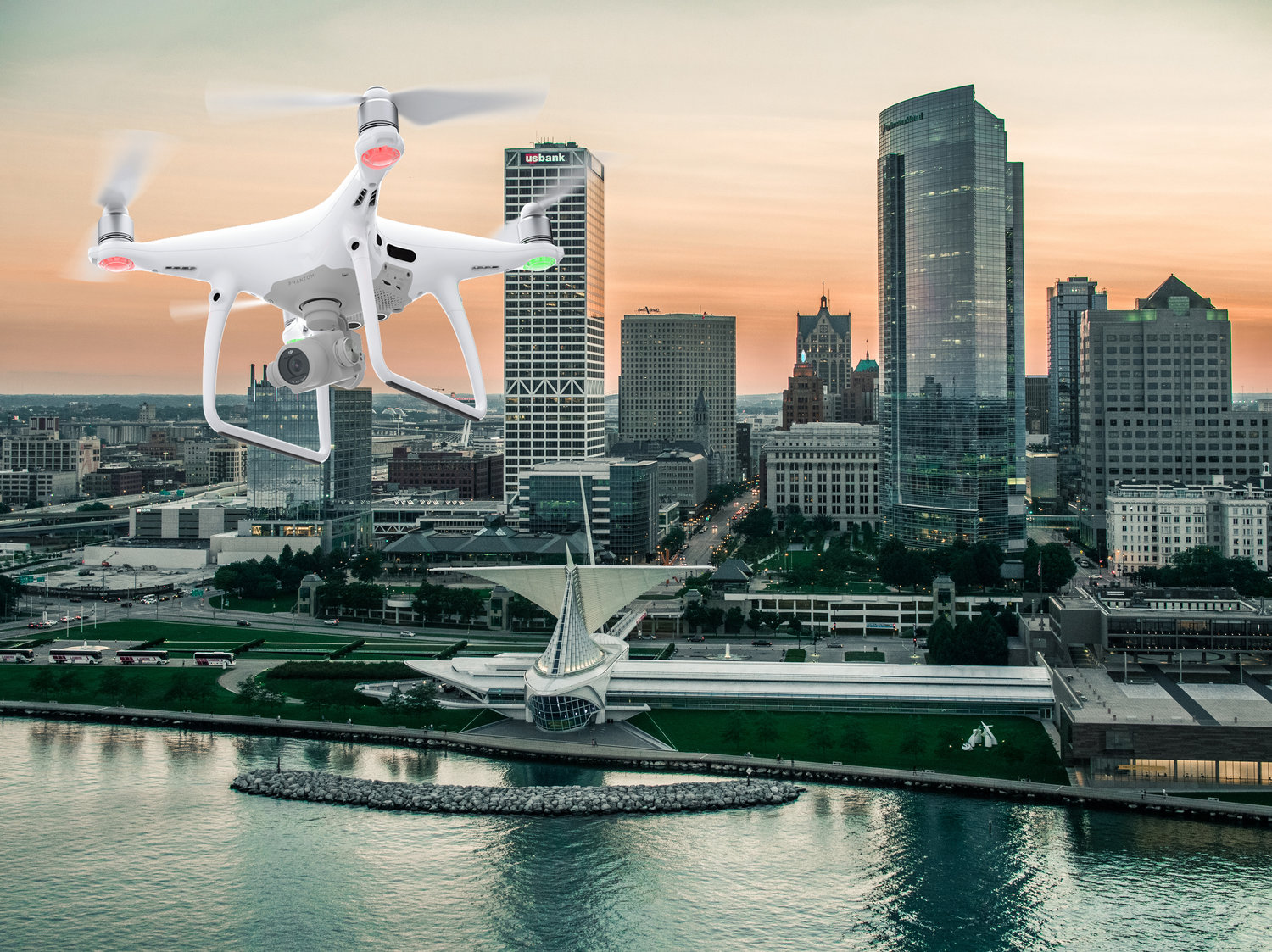
Surveillance & Security Drone

Slide 7
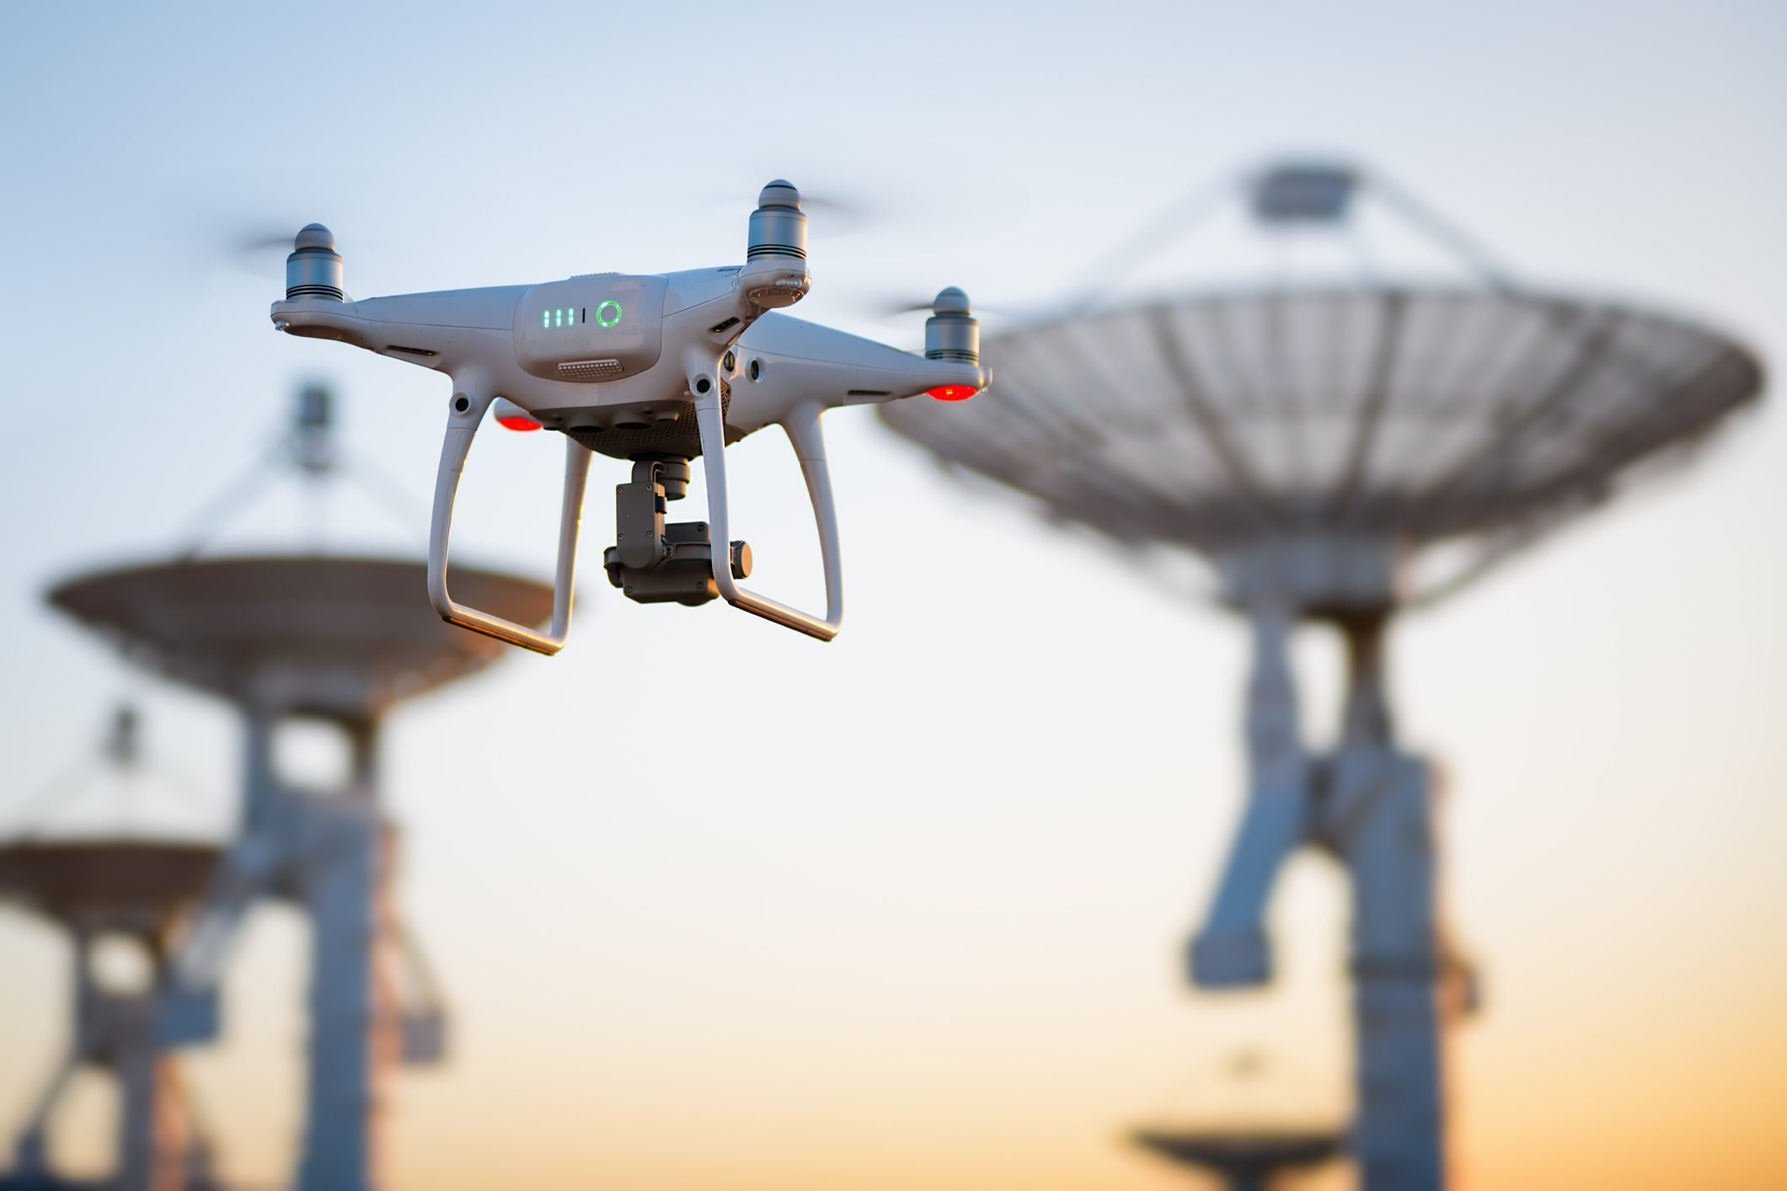
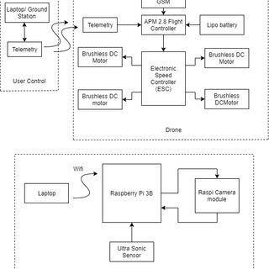
DESIGN
The design of the system is divided into three parts i.e.
User Control
Drone and
Surveillance.
The user control part includes the laptop (base station) and the transmitting radio telemetry device.
The drone consists of flight controller, receiving radio telemetry, GPS module, electronic speed controllers, brushless motors and a lipo battery for the power
supply. In the same way, the surveillance part includes the Raspberry pi 3B microcomputer, laptop, raspberry pi camera module and the ultra-sonic sensor

Slide 8
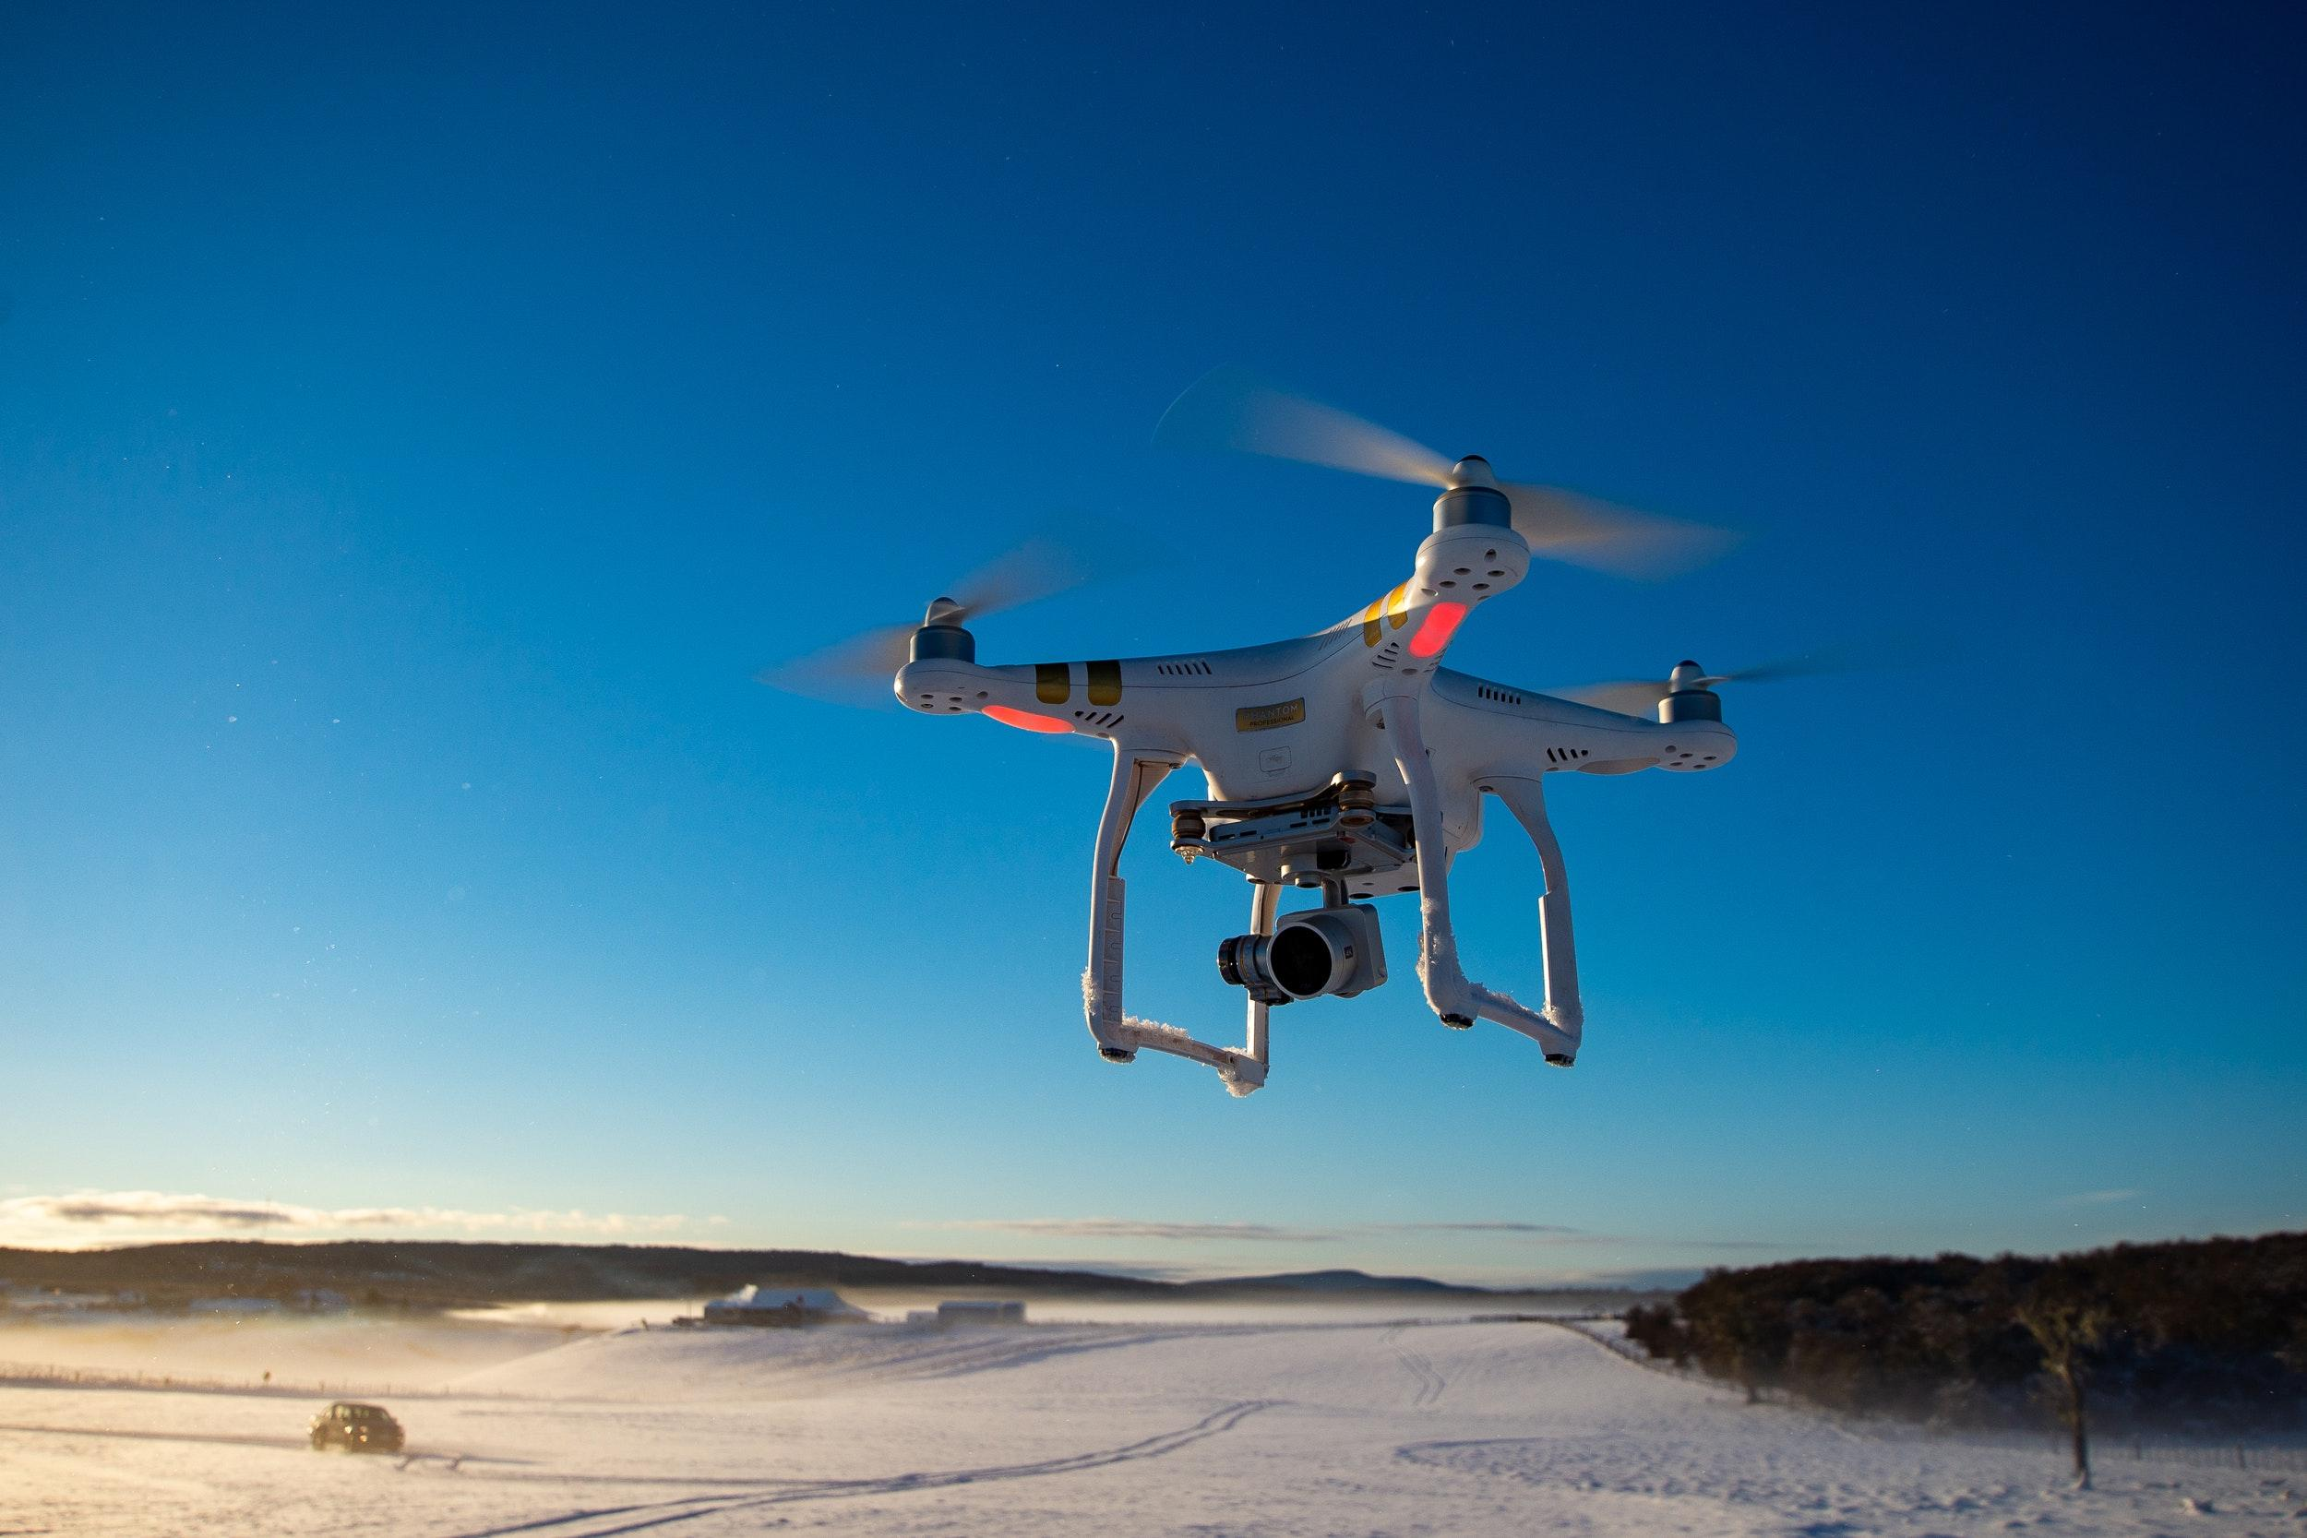
DESIGN continued
The User control part is the transmission part of the system. The command is provided to the drone from the laptop via the transmitting telemetry device. Thus, from the ground station the flight of the drone can be controlled.
The drone is the main part of the system. The command delivered from the laptop is received by the receiving telemetry device and the command is processed by the flight controller and thus the action which is demanded by the command from the ground station (laptop).
The surveillance part performs the live streaming task. For the live video the raspberry pi is connected to the Wi-Fi and is provided with an IP address. The provided IP works as a wireless LAN. Then with the use of simple python code the HTML page is rendered for displaying the video from the pi camera.
The rendered page can be accessed from any devices connected in the same network as pi by using the IP and the provided port number. The Surveillance part also includes the ultrasonic sensor for detecting the obstacle in between the path of flight and hence for the avoidance of the obstacle.

Slide 9

Drones, UAV for Aerial Surveillance
Surveillance drones are unmanned aircraft used to gather still images, video recordings or live video of targets such as people, vehicles or specific areas.
They may be used by governments, militaries, law enforcement or commercial entities to gather information and intelligence that can be used to assist decision-making.
Using drones for surveillance can provide access to areas that may be difficult or impossible to reach by humans on foot or in land vehicles.
Many drones are quieter than manned aircraft, can fly at lower altitudes and are less expensive to operate.
Using military and law enforcement surveillance drones in potentially dangerous environments such as battlefields or crime scenes can also prevent putting humans at risk.

Slide 10
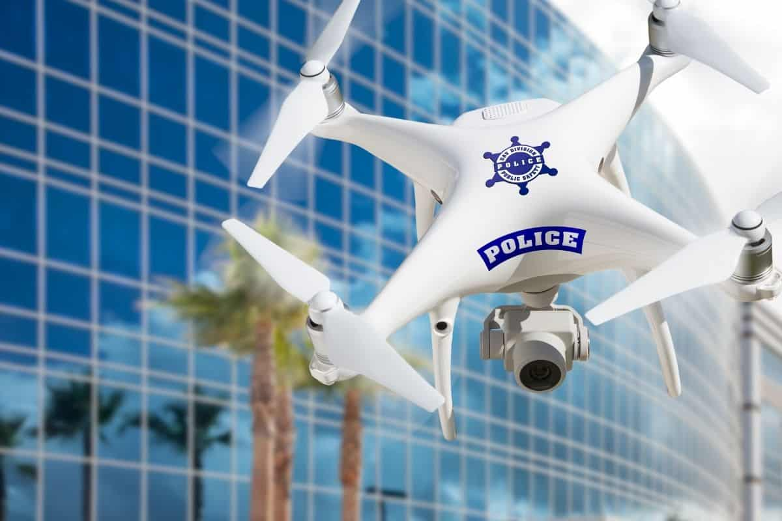
police surveillance drone

Slide 11
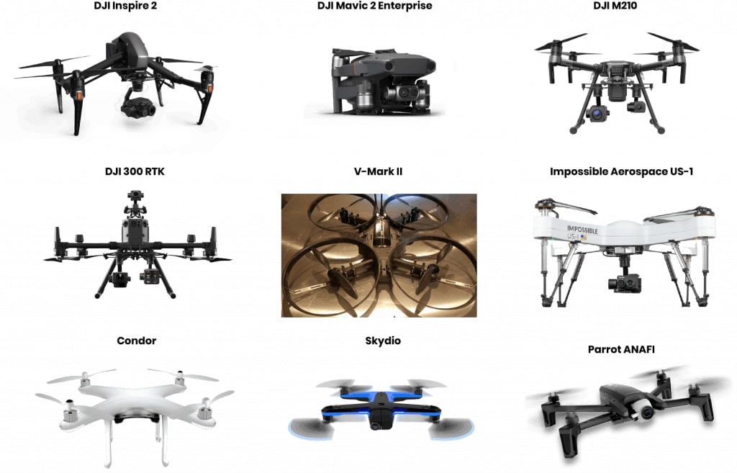
Drones that are popular in police department

Slide 12
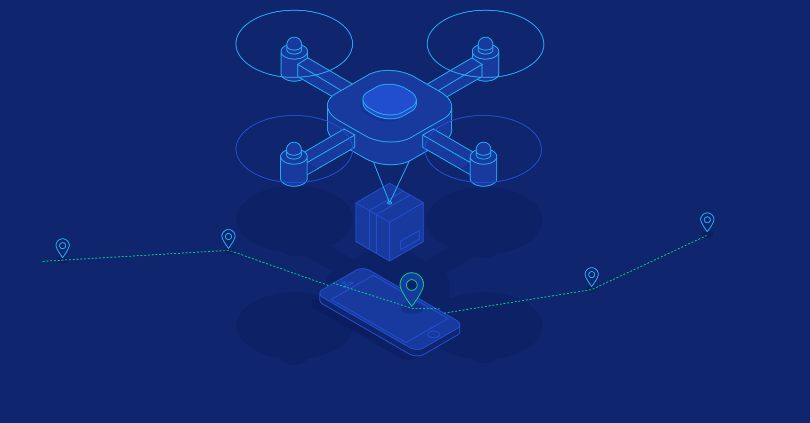
Definition of police surveillance drones
Police drones are equipped with high-definition cameras having powerful zoom capabilities, combined to thermal cameras, able to see during the night like in daylight.
These drones can take-off almost anywhere or keep hovering for a long time.

Slide 13
Why Are Drones Useful for Police Departments?
Cost Effective – Drones require much lower capital and operating expenditures compared to traditional police air support helicopters.
Lower Barrier to Entry – It is far easier to train law enforcement officers to operate drones in police related deployments rather than training them to pilot air support helicopters. The associated costs are significantly reduced as well.
Rapid Aerial Surveillance -Drones allow police departments to survey crime scenes and search grids within moments of arriving on scene, and to do so much more comprehensively from the air.
Efficiency – Drones can be deployed significantly quicker than traditional police air support helicopters
Reduced Risk – Since drones are remotely operated, they allow police officers to conduct crime scene searches and assess dangerous situations up close (such as active shooter incidents) prior to having to physically send police officers into harm’s way

Slide 14
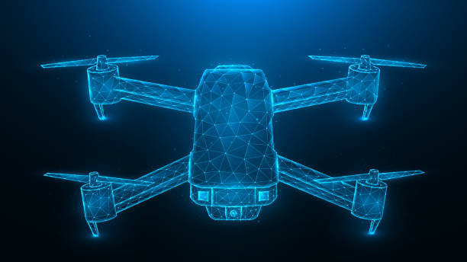
What to Know Before Using Drones
FAA Rules and Regulations – Without a special waiver, current FAA regulations only allow drones to be flown during daylight hours, no higher than 400 feet and no faster than 100 miles per hour. Additionally, the aircraft must remain in the visual line of sight of the remote operator.
Costs of Setting Up a Drone Program – Flying a drone for commercial use requires training. While the benefits far outweigh the costs, it’s important for police departments to understand their goals and create a plan before purchasing hardware.
Risk of Lawsuits - Similar to any other collision, if a drone crashes, any harmed individuals may be able to bring upon a lawsuit. This further emphasizes the importance of training, and understanding the rules and regulations, so oil and gas firms can fly safely and compliantly.

Slide 15

Drone surveillance is an ideal choice when it comes to large events such as concerts, political rallies, and marathons.
They can be deployed very quickly and provide you with an overview to prevent illegal activity and protect attendees.
CONCLUSION

Slide 16


